Slide 1

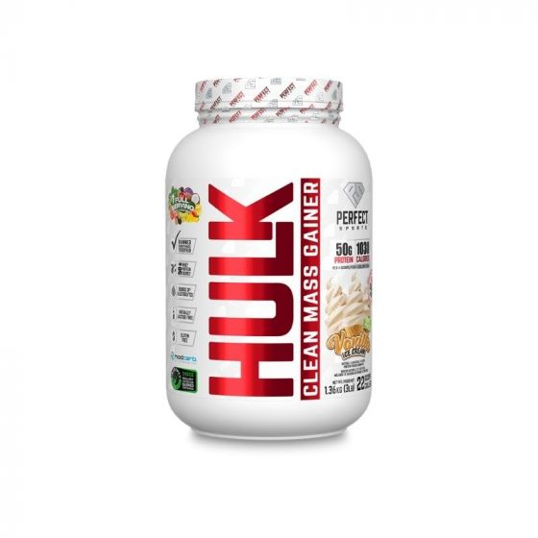
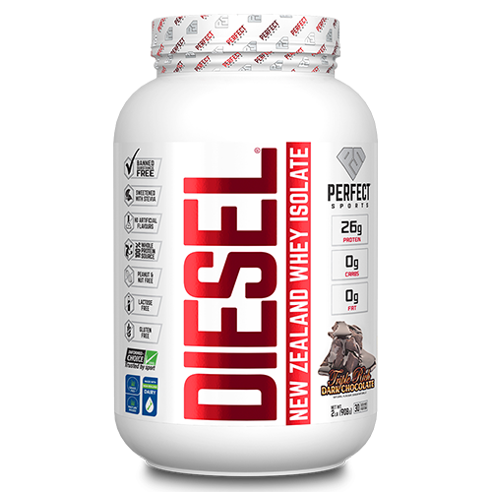
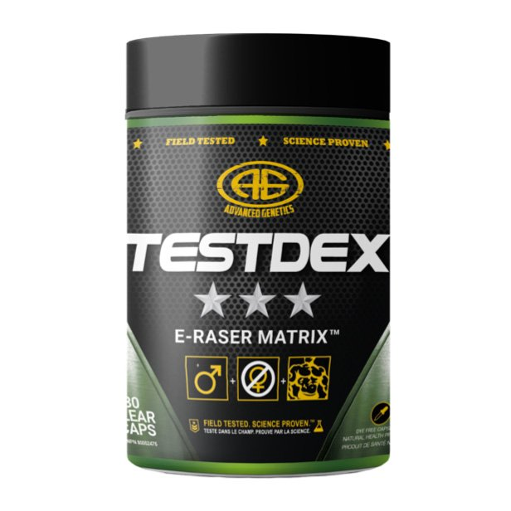
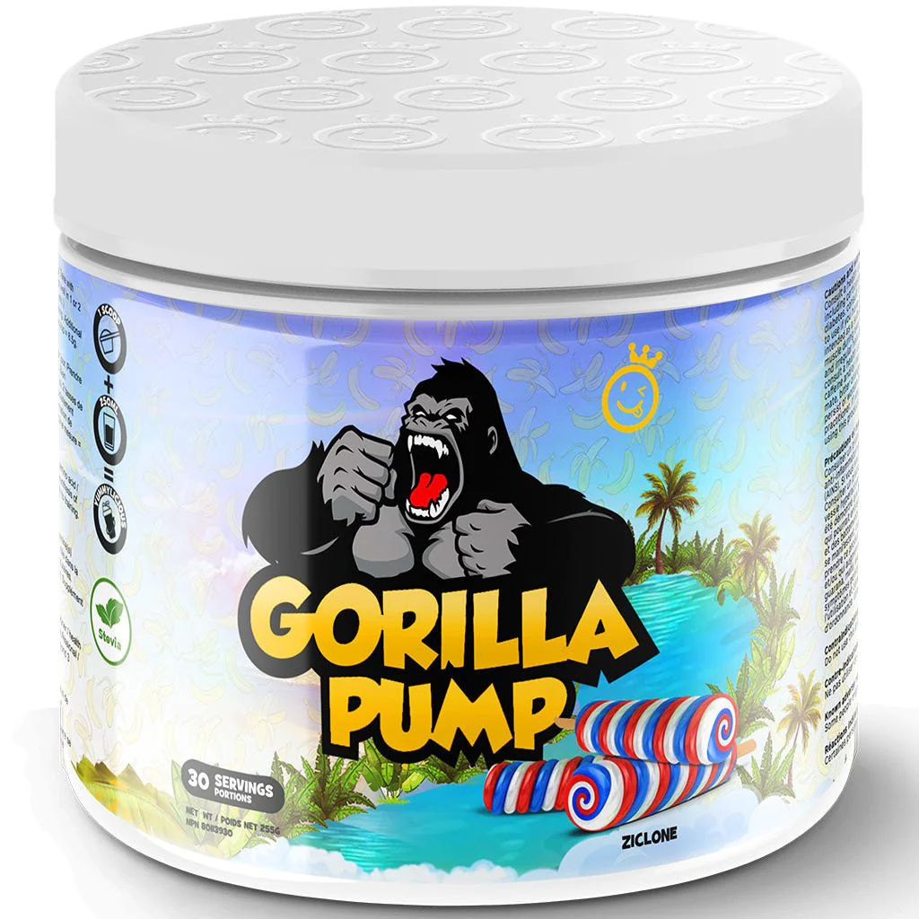
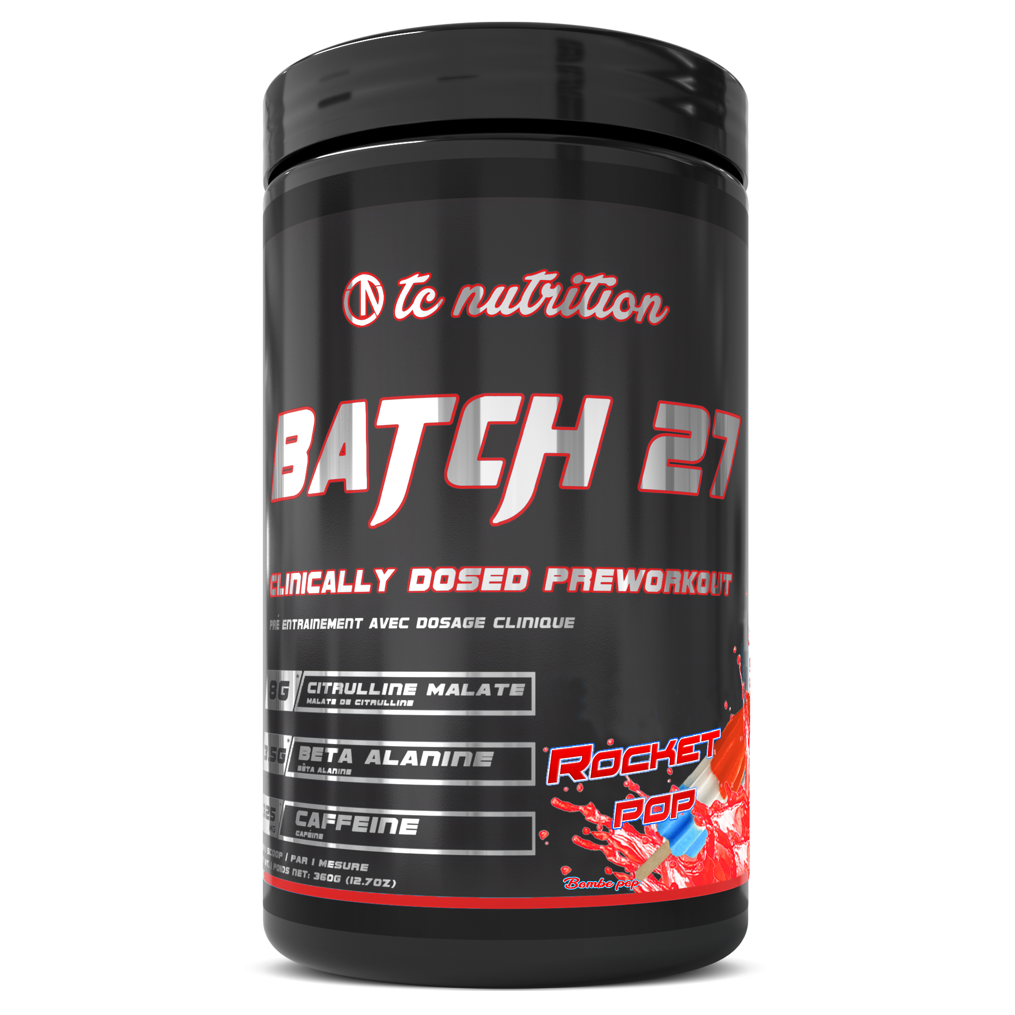
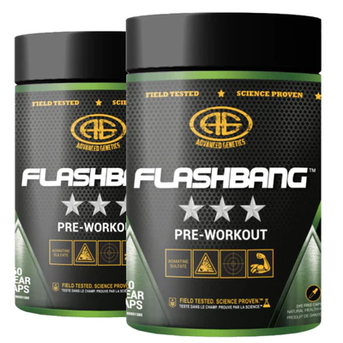
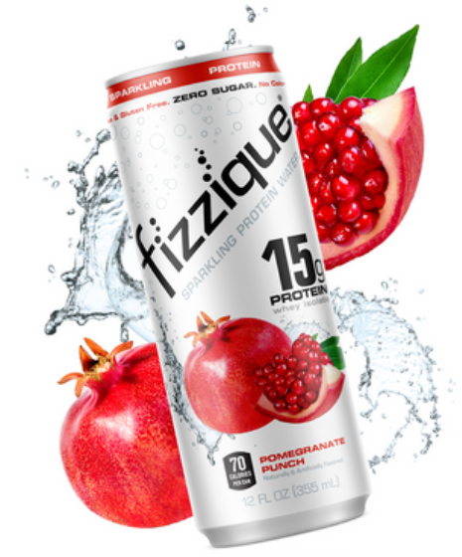
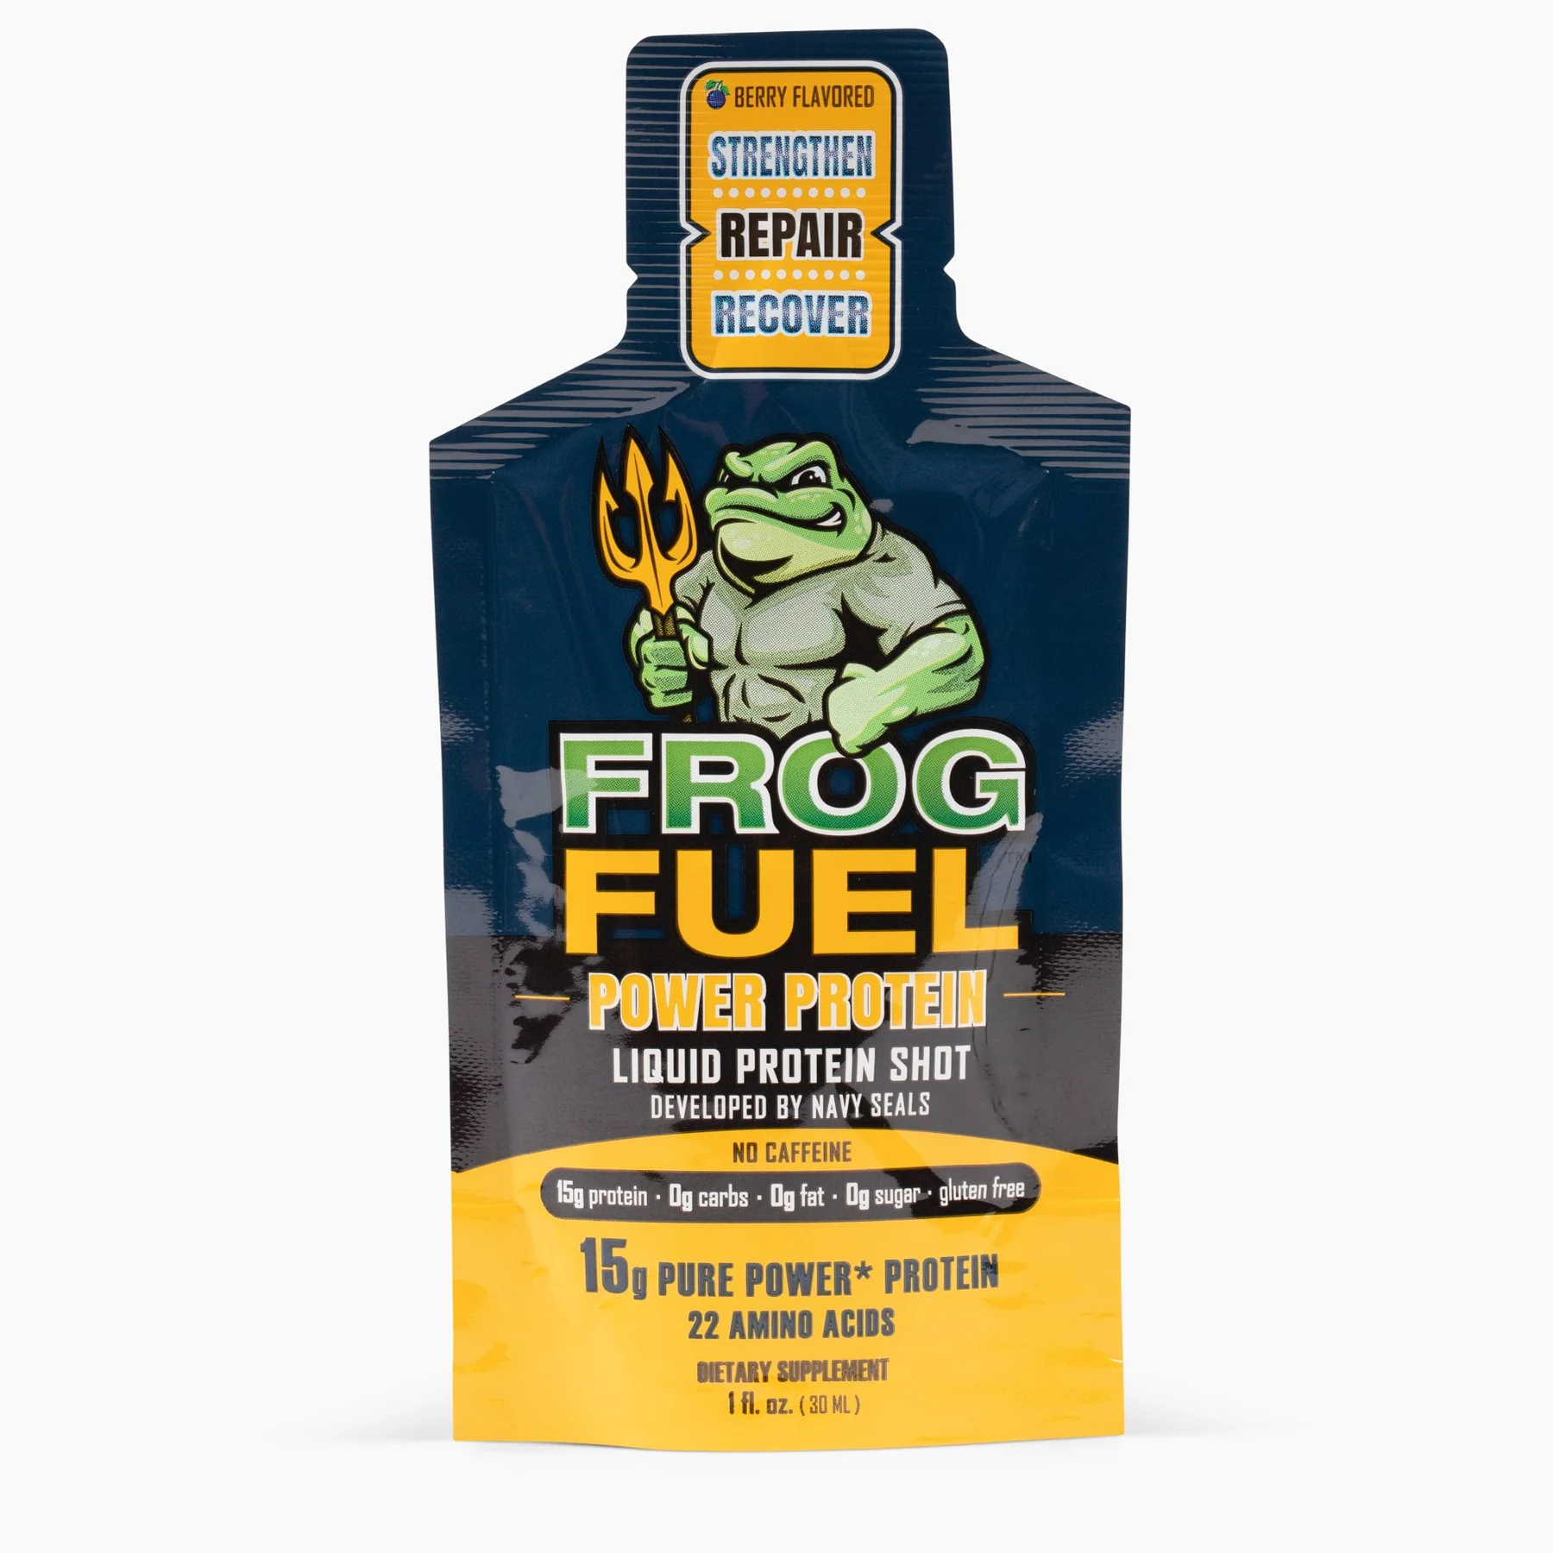
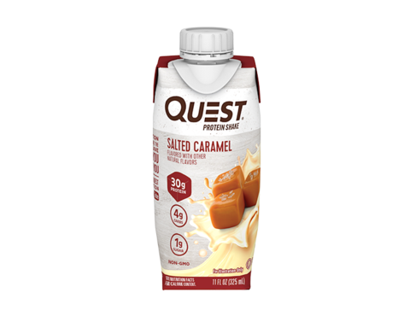
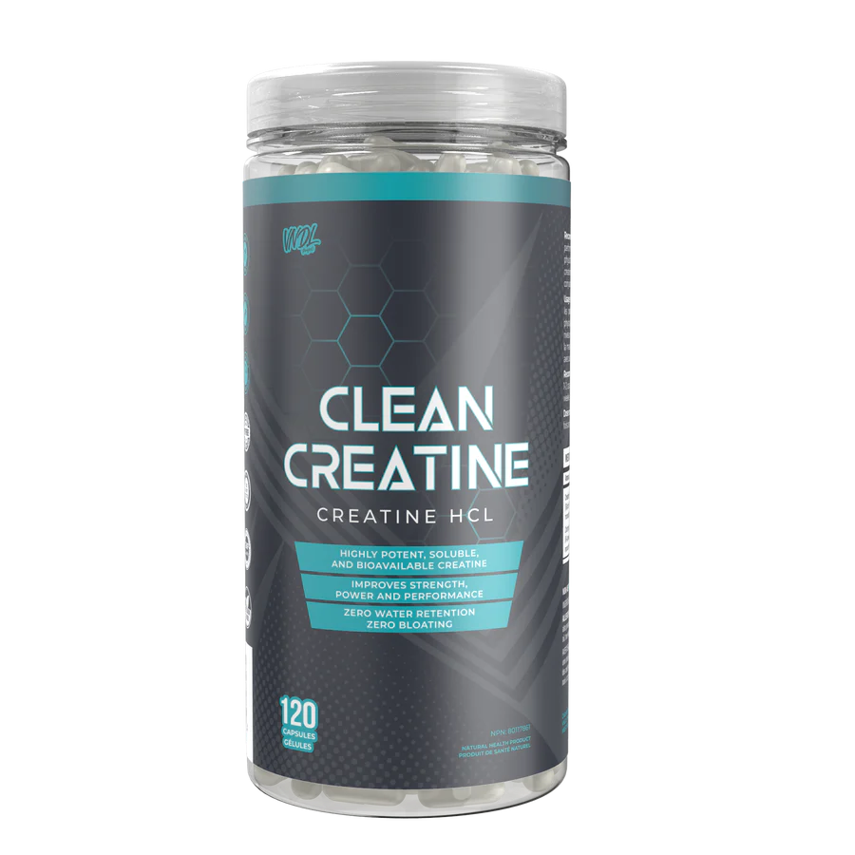
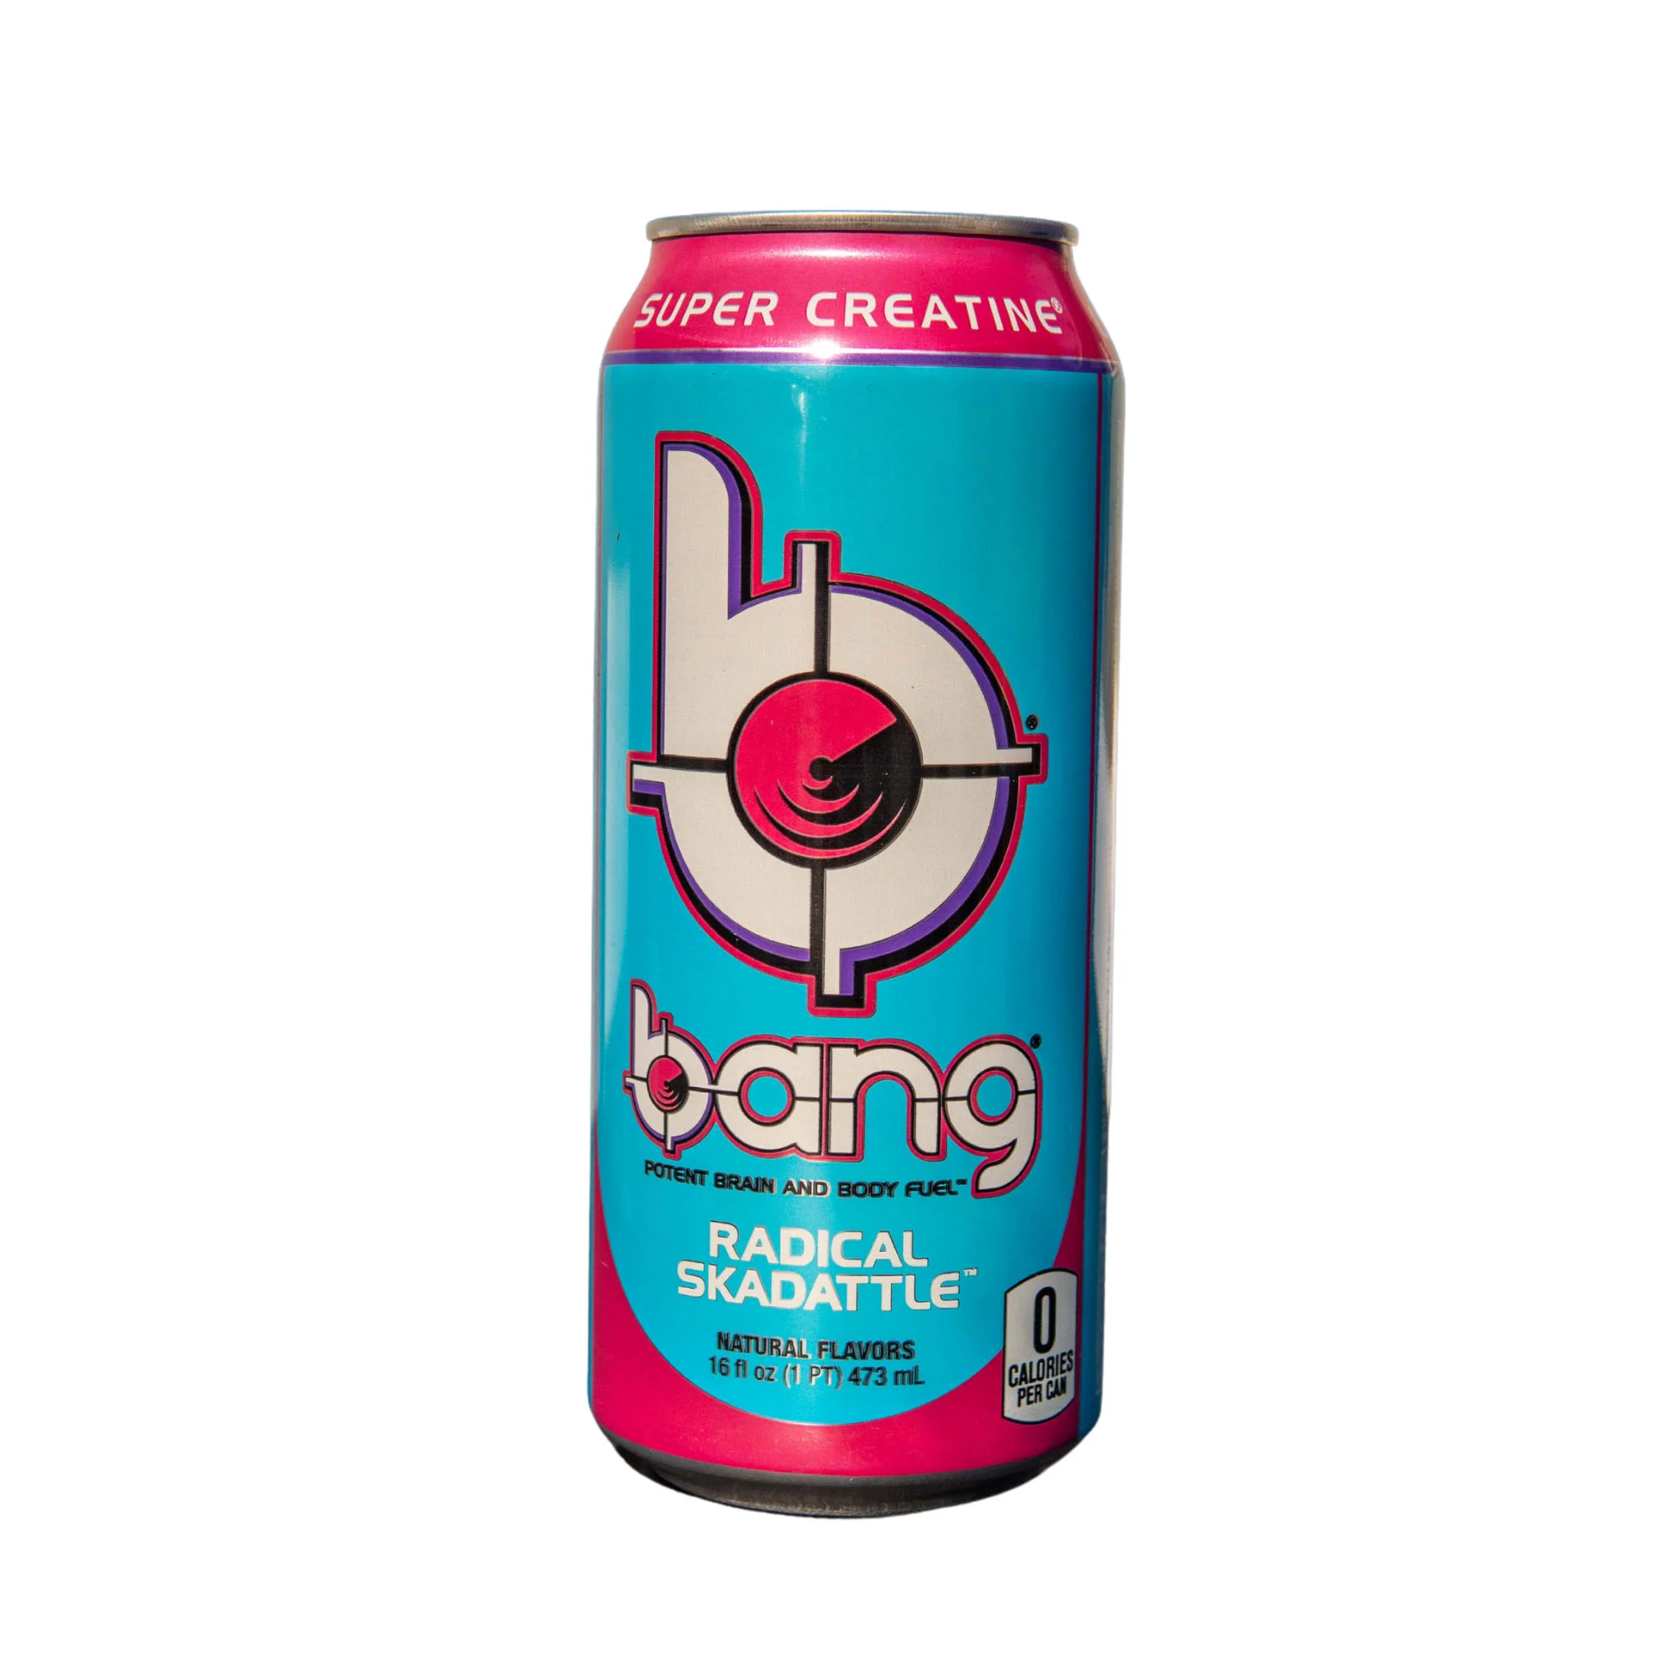
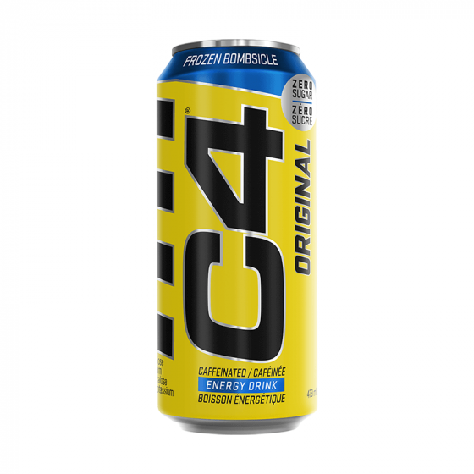
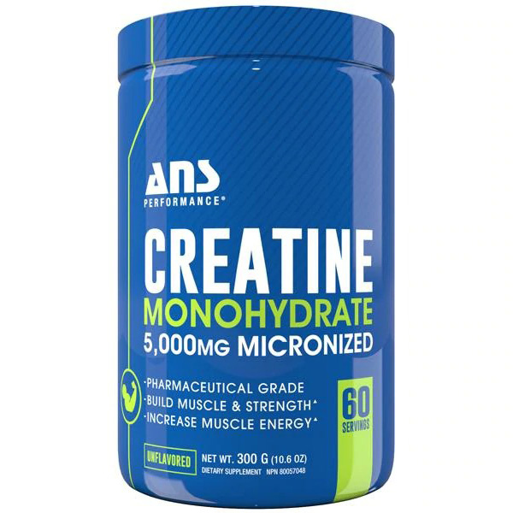
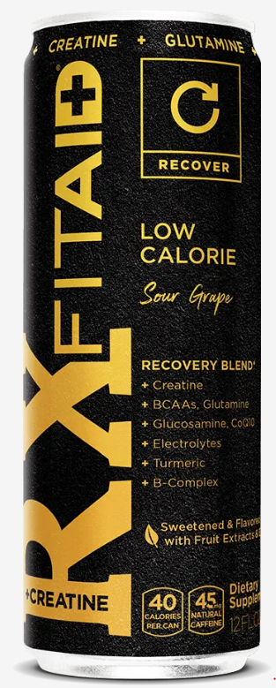
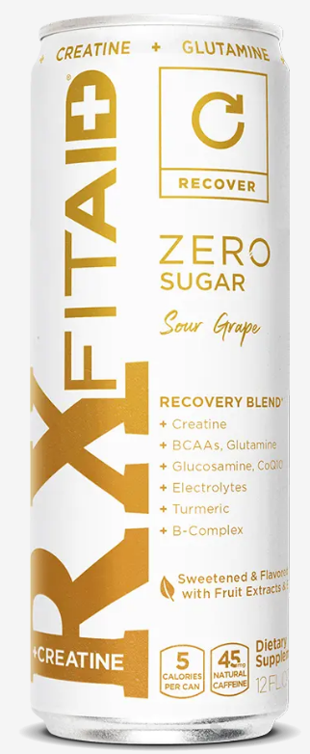
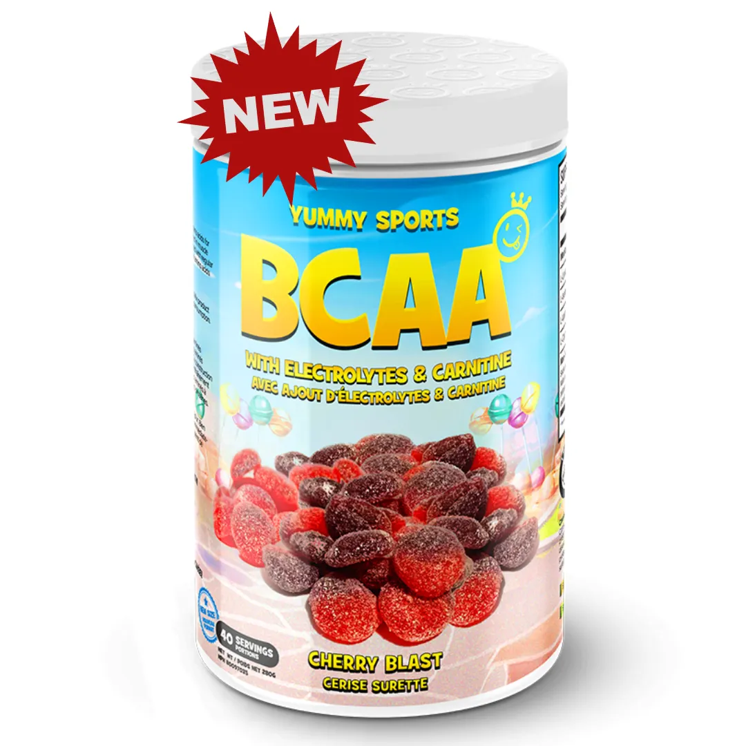
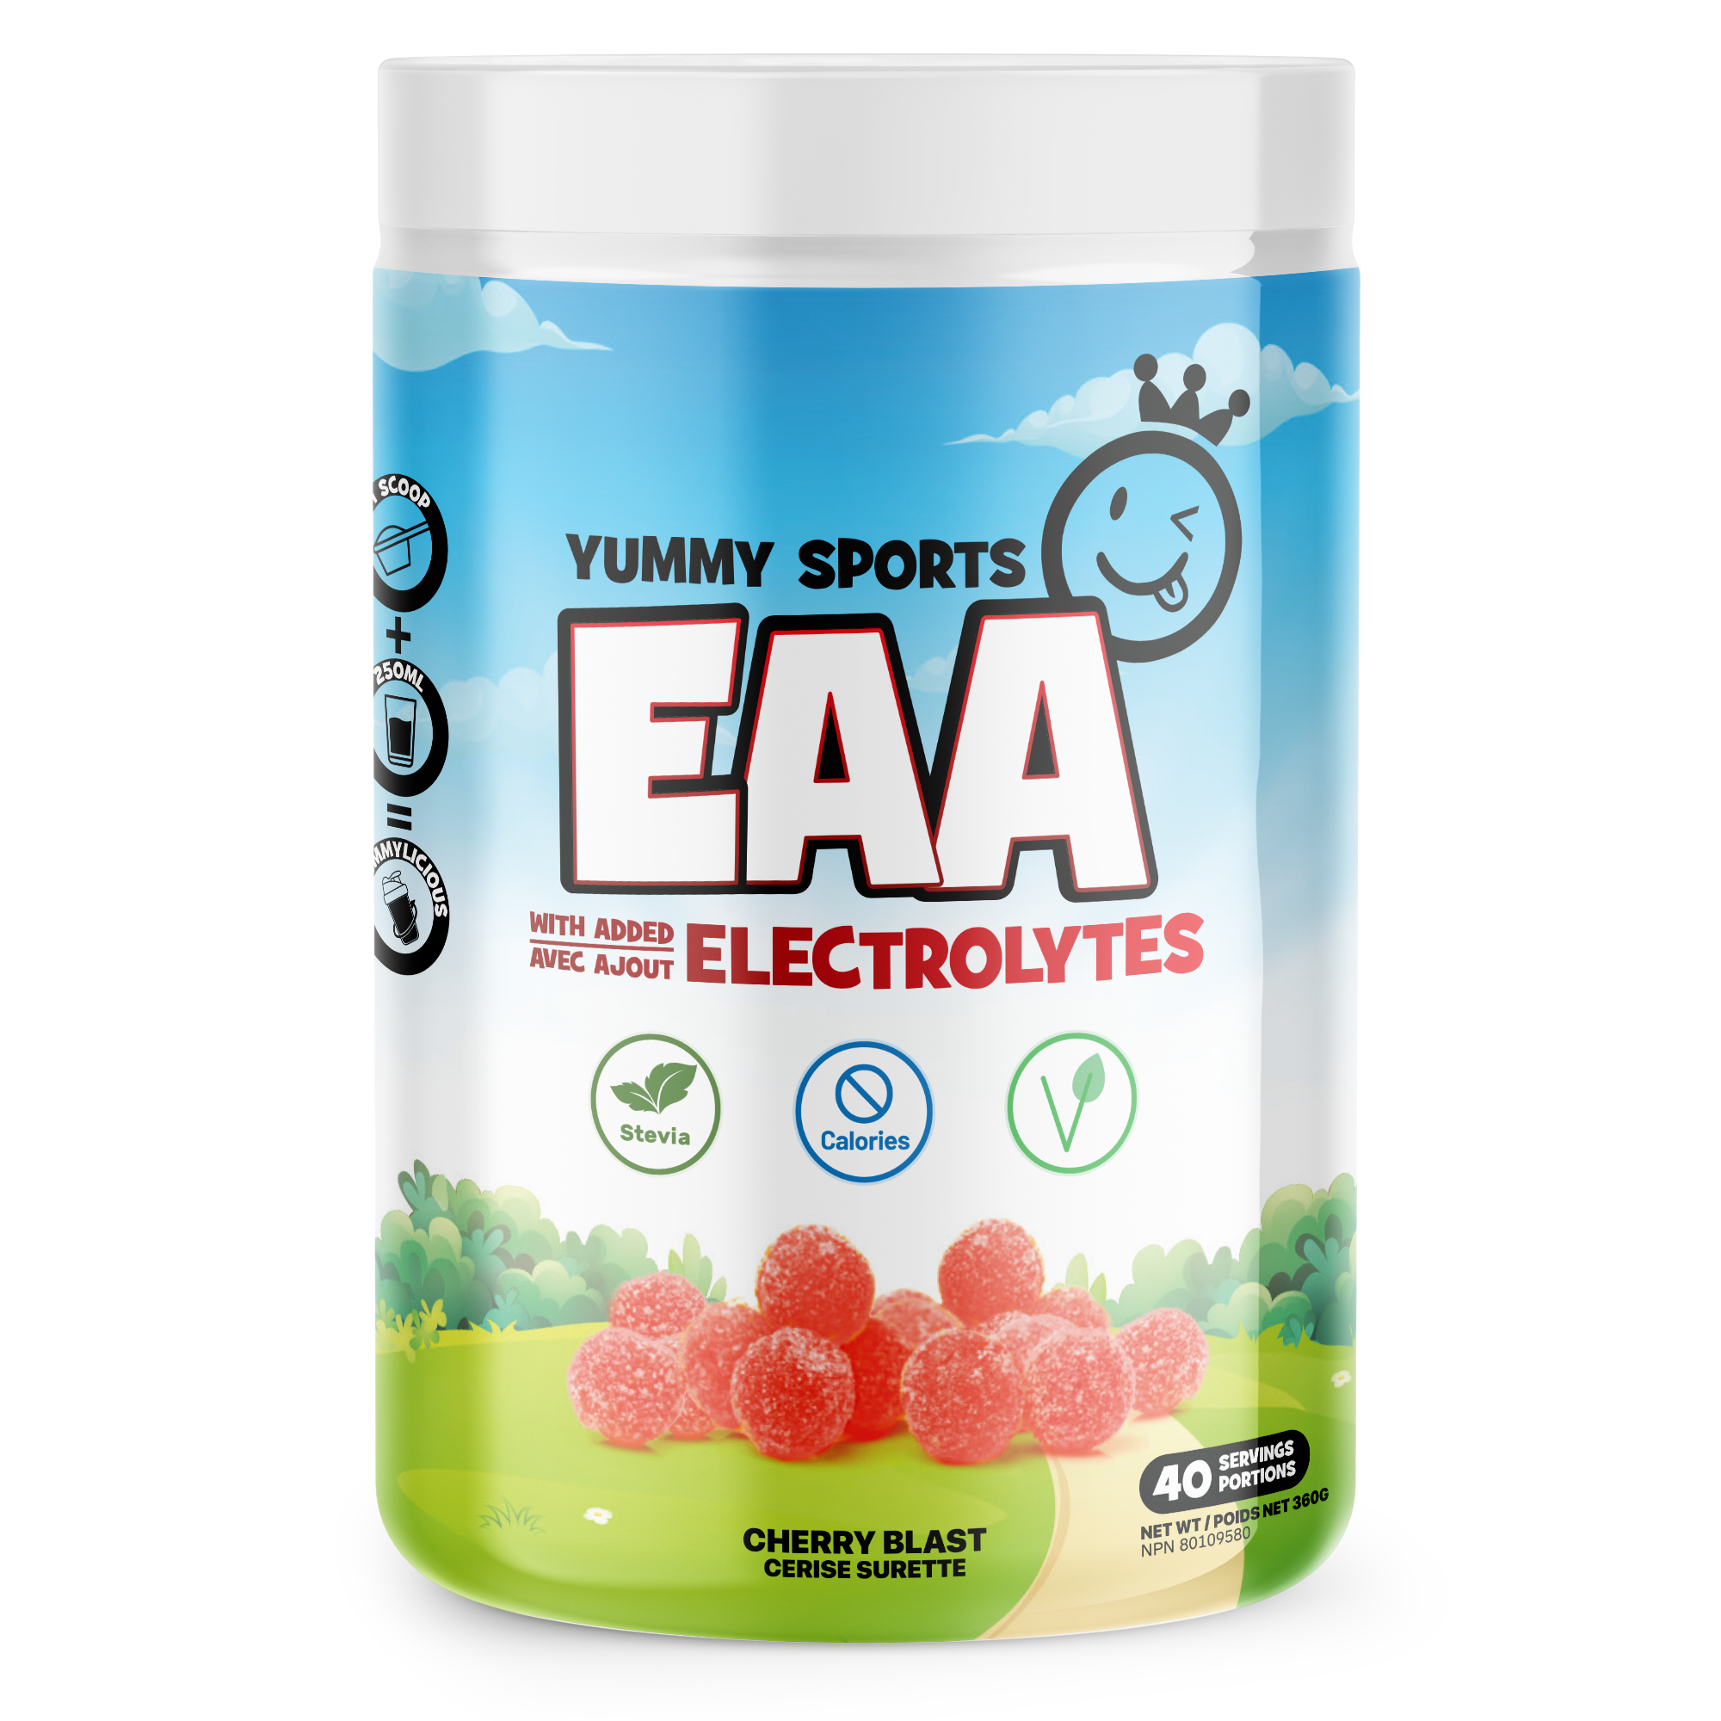

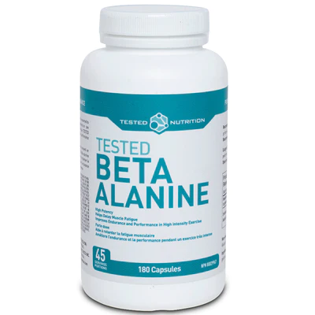
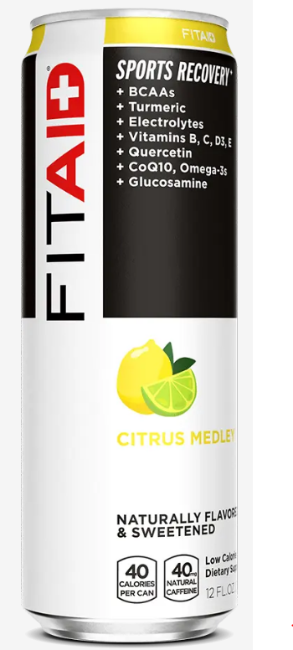
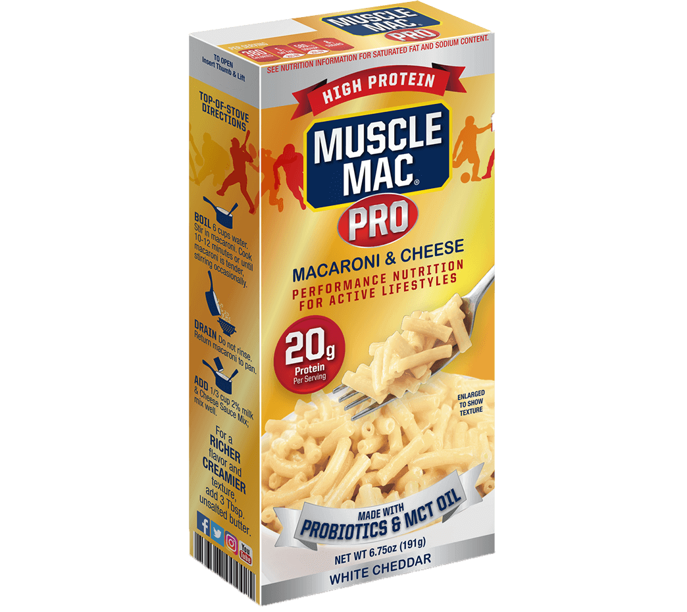
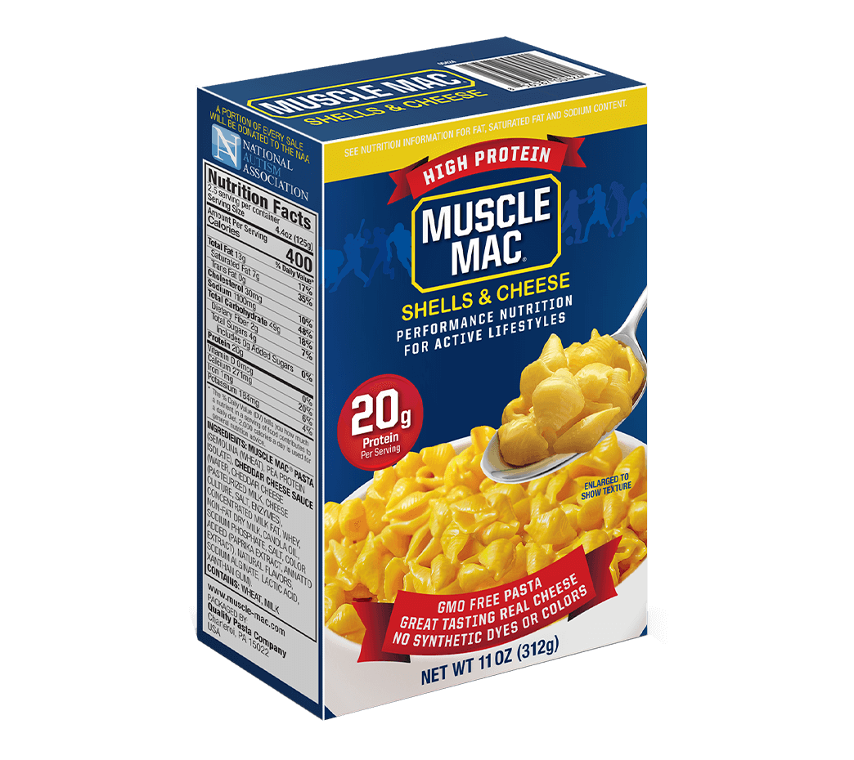
Guide des suppléments
Masse musculaire et endurance
Boost énergie pour l’entrainement
  Pre-workout
  Boisson énergétique
Repas Protéiné
  Protéines et
  réduction d’estrogène
  Créatines
  Acides aminées (EAA, BCAA Béta Alanine)

Slide 2
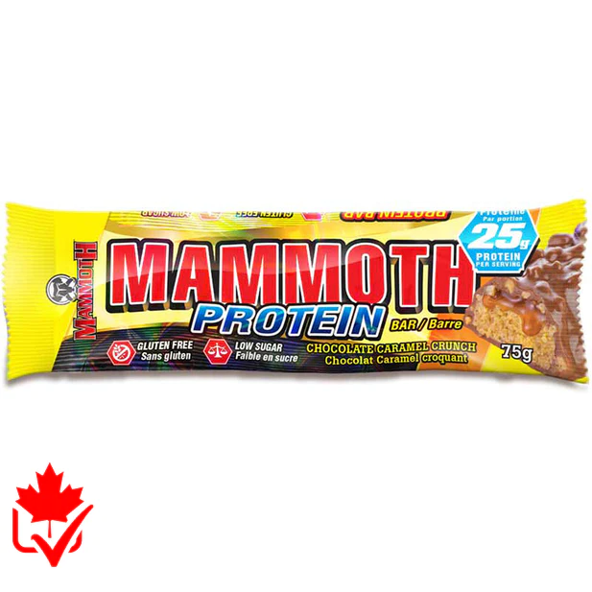

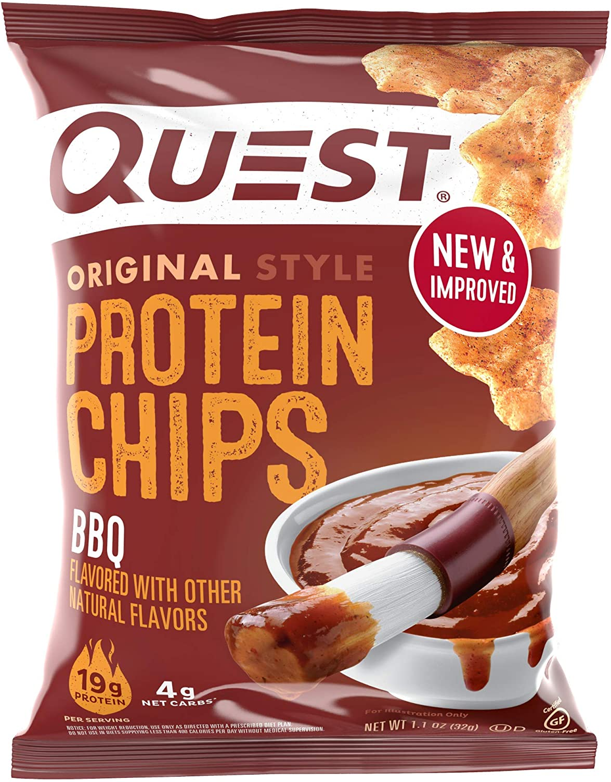
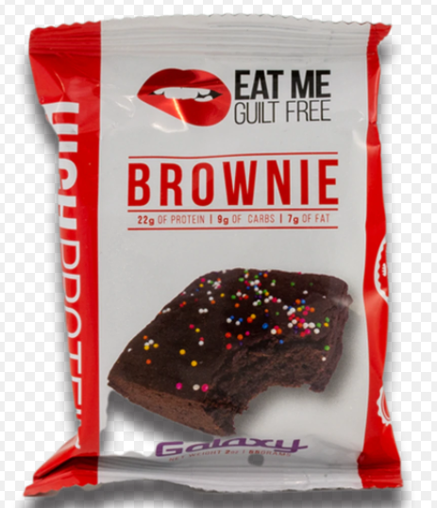
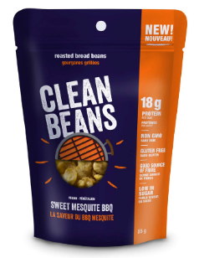
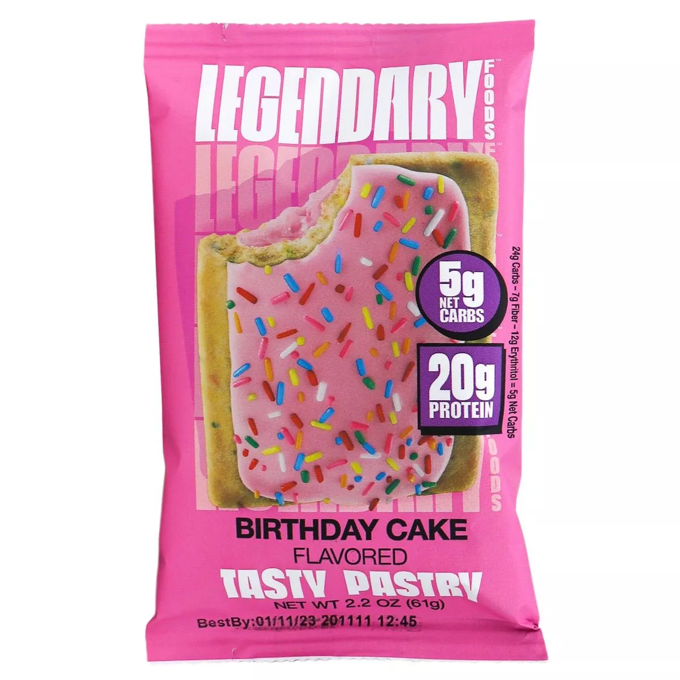
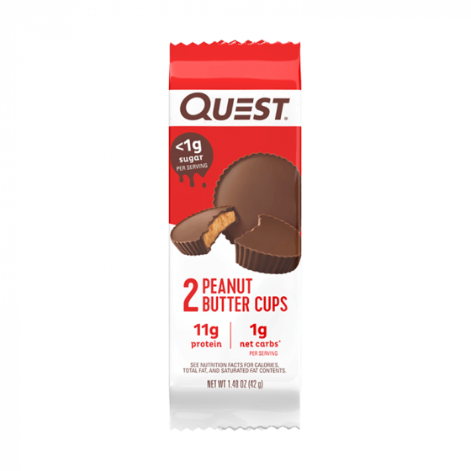
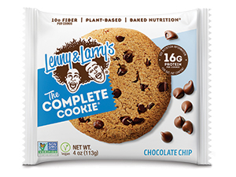
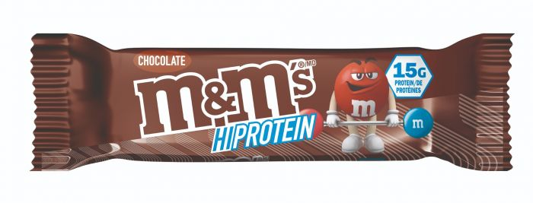
Guide des suppléments
Collations protéinées
  25 g prot. Sans gluten
  16-21 g prot
  11-16 g

Slide 3
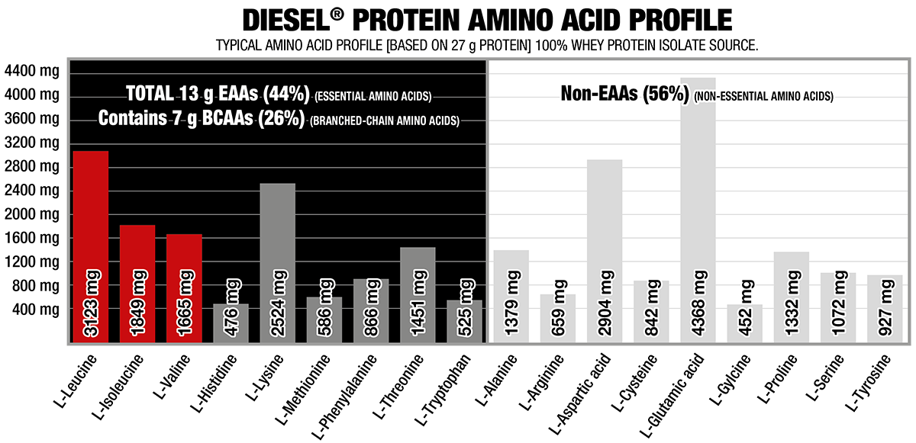
DIESEL® IS EVERYTHING A PROTEIN SHOULD BE!
THE PERFECT PROTEIN
With 0 g sugar, 0 g carbs, 0 g fat
Up to 27 g of bio-available protein,
Ultra-fast absorption ensures that you recover from your training stronger (and leaner) than ever.
DIESEL ® is Number #1 Selling New Zealand Whey Protein Isolate on the market

Slide 4

HULK CLEAN MASS GAINER – ALL-IN-ONE FORMULA
With over a 1,000 muscle-feeding calories per serving, HULK Clean Mass Gainer provides your body with the high-quality nutrients it needs to help support substantial increases in growth.
60 g Protein including 10 g Aminos
Insanely Low in Sugar (ONLY 2 Grams!)
Full Serving of Fruits and Vegetables
Lactose-Free & Gluten-Free

Slide 5
Build muscle fast!
TESTDEX WILL:
  raise testosterone and reduce estrogen
  increase lean muscle mass
  boost strength and power
  improve muscle hardness
  spike libido and sexual performance
  lower cortisol
HOW TO USE:
  Testdex is taken one capsule, once per day. It is best to take Testdex at the same time every day. Cycle 4 weeks on, 1 off.
What kind of results will I get with Testdex?
  Every individual is different, but you should start feeling changes within 7 days of starting Testdex.

Slide 6
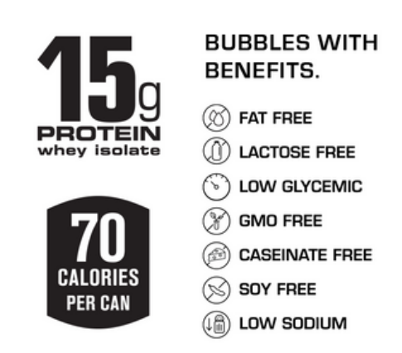
SPARKLING PROTEIN WATER
Unreal taste that is bursting with flavor and protein in every drop.
The most amazing things happen when hydrogen, oxygen, whey protein, and carbon dioxide do the tango.
When to take C4
25-30 min before workout

Slide 7
FROG FUEL DIGESTS 4X FASTER THAN WHEY PROTEIN
Frog Fuel’s nano hydrolyzed collagen® protein digested completely within 15 minutes. The same amount of whey protein from a leading brand took over 60 minutes to digest completel
Nano-Hydrolyzed Collagen® protein from grass-fed cows
15g liquid protein per shot
0g of Carbohydrates
22 Amino Acids
Fortified Amino Acids: Glutamine, Cysteine, Histidine, Methionine, Threonine, Taurine & Tryptophan
NO Sugar, Fat, Gluten, or Lactose
NO banned substances and no GMOs

Slide 8
Protein Shakes on the go!
Naturally flavored shake that provides your body with:
30g of protein
3 grams of carbs
1 gram of sugar.
non-GMO
Gluten Free

Slide 9
Power Strength & Power Amplifier
Creatine significantly boosts muscle strength, power, and size during high-intensity exercise.
ANS Performance Creatine monohydrate is micronized (making the particles smaller) for improved mixability and performance. Increased muscle levels of creatine
Why take Creatine
Creatine is involved in the regeneration of ATP (Energy molecule) during short-term, high intensity activities.
When our muscles run out of creatine, our short-term anaerobic energy system shuts down and our muscles can no longer perform optimally.
Increased work capacity and improved training
Greater increases in lean body mass
How to use Creatine
Goal = saturate muscles stores with creatine by 2 ways :
Pre-Loading Method: Take approximately 20 grams of creatine monohydrate per day for 5-7 days, followed by a ‘maintenance dosage’ of 3-5 g/day thereafter.
Steady Load Method: Take 3-5g of creatine monohydrate per day. Saturation is typically achieved within 30 days.
Timing is not really critical with creatine supplementation, but the science suggests that there may be a slightly higher benefit to taking creatine after your workout.

Slide 10
Power Strength & Power Amplifier
CLEAN CREATINE is highly soluble & potent, allowing for a smaller dose to achieve benefits and the convenience of only 1-2 capsules per serving.
Does not create nausea and bloating like other forms of creatine monohydrate.
A convenient Creatine Supplement; third party tested for purity, safety, and quality.
Why take Creatine
Creatine is involved in the regeneration of ATP (Energy molecule) during short-term, high intensity activities.
When our muscles run out of creatine, our short-term anaerobic energy system shuts down and our muscles can no longer perform optimally.
Increased work capacity and improved training
Greater increases in lean body mass
How to use Clean Creatine
Take 1-2 capsule(s), 1-2 times a day. Use for a minimum of 4 weeks.

Slide 11
BCAA + Carnitine
Maximize protein synthesis, stay hydrated, and satisfy your sweet tooth while burning fat!
What is BCAA (Branched-Chain Amino Acids)
BCAA are building blocks for protein and muscle.
increase muscle growth,
reduce soreness and fatigue,
prevent muscle wasting, and support liver health.
They are also found in a variety of food sources, including meat, eggs, and dairy products.
What is Carnitine
Carnitine helps preserve muscle glycogen and promote fat oxidation. It also spares the use of amino acids as energy sources during exercise, making them potentially available for new protein synthesis, and decreases the accumulation of lactate
When to take BCAA:
15 min pre-workout or during a workout to prevent fatigue

Slide 12
EAA : Get back to the gym faster and happier!
EAA are essential amino acids required to build muscles, that are not found in all food sources.
They improve muscle growth, increase your endurance, and reduce soreness post exercise.
Optimize liver function and neurotransmitters in the brain.
9 Essential Amino Acids are: histidine, isoleucine, leucine, lysine, methionine, phenylalanine, threonine, tryptophan and valine
When to take EAA
Before, during or after training.

Slide 13
Enhance your performance & Reduce muscle fatigue!
Beta-alanine enhances performance by increasing exercise capacity and decreasing muscle fatigue. It also has antioxidant, immune-enhancing and anti-aging properties. You can get beta-alanine from foods that contain carnosine or through supplements.
Increase Strength
Boost Muscular Endurance
Train with Greater Intensity
Boost Intra-Muscular Carnosine
100% Pure Pharmaceutical Grade
Why take Beta Alanine
Beta Alanine is converted in to Carnosine which is a protein building block that is naturally produced in the body. It is found in muscles, the heart, brain, and many other parts of the body.
Carnosine is important for many normal body functions. There's interest in using it to prevent aging because it seems to block certain chemicals that might play a role in the aging process. Carnosine levels in the body might also go down with age
When to take Beta Alanine
15-20 min before a workout

Slide 14
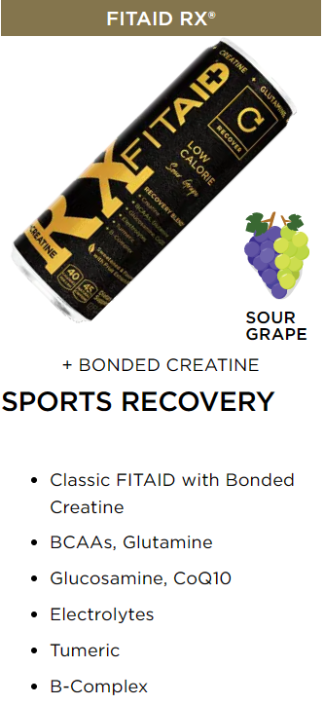
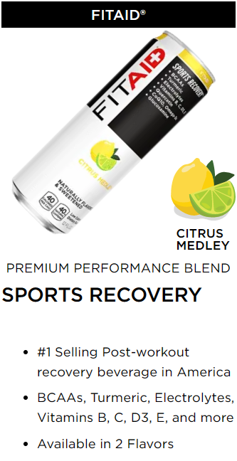
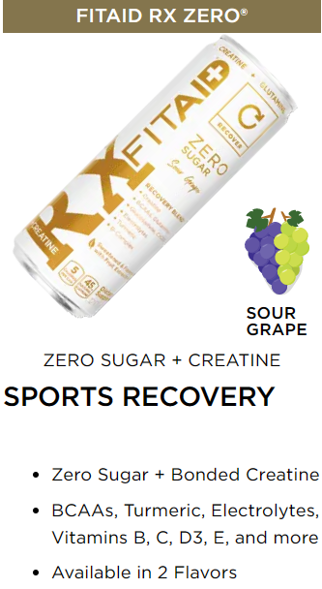
Sport recovery drinks
Gluten free
No saccharose
Non MGO
Vegan

Slide 15
Pre-workout without Stimulants
Gorilla Pump is the newest non-stimulant pre-workout pump formula.
The active ingredients provides you with a fast and efficient pump throughout your workout.
The combination of quality and active ingredients makes it the perfect ally to crush your gym session.
It contains a very balance dosage of Citrulline, Glycerol, Arginine and Agmatine that works together to give you this amazing ‘’full muscles’’ sensation !

Slide 16
Impactful Pre-Workout with less stimulants
Not all pre-workout are created equal.
Batch 27 from TC Nutrition is not packed with stimulants.
  325mg of caffeine in each serving
  Eight grams of citrulline malate
  3.5 g of beta-alanine
Why take Pre-workout
Fight the fatigue to get you trough your workout.
Provide massive muscle pumps
Increases strength and power
Improves focus and energy
Provides a boost of endurance
When to take Pre-workout
30-60 minutes before a workout

Slide 17
The World's Strongest Pre-Workout Capsule!
Get insane pumps and focused energy!
Improve nitric oxide synthesis
Increase cerebral blood flow
Has neuroprotective properties
Increase blood flow to muscles
Improves endurance
Provide mind clarity
1,000 mg of pure Agmatine and the one/two punch of the barely legal caffeine/synephrine combo, this formula will power you through the most hardcore of workouts!
Why take Pre-workout
Fight the fatigue to get you trough your workout.
Provide massive muscle pumps
Increases strength and power
Improves focus and energy
Provides a boost of endurance
When to take Flashbang
1 pill, 20-30 minutes before a workout

Slide 18
Awaken Your Superhuman Performance
C4® pre-workout is the fastest-growing energy drink brand
Packed clinically studied, premium ingredients to support muscular endurance, hydration, and physical performance for sugar-free energy you can feel.
Powered by Caffeine, Arginine, Taurine, and other key ingredients that support explosive energy, alertness, and performance
zero sugar, sodium, carbs, and calories,
When to take C4
25-30 min before workout

Slide 19
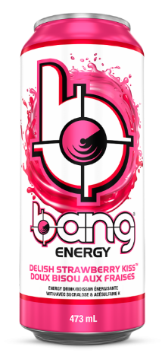
BANG® Energy drinks
Not your stereotypical high sugar, life-sucking soda masquerading as an energy drink!
High sugar drinks spike blood sugar producing metabolic mayhem causing you to crash harder than a test dummy into a brick wall.
Power up with BANG® Energy Drink’s potent brain & body-rocking fuel:
Caffeine & BCAAs (Branched Chain Amino Acids).*

Slide 20
Muscle Mac Shells & Cheese
Smooth & creamy cheddar cheese that your whole family will love with all the comfort-food goodness you want.
20 grams of protein per serving
No synthetic dyes & colors
GMO free pasta
Dairy & Vegetable protein

Slide 21
Muscle Mac Macaroni & Cheese
Take care of your taste buds and gut!!!!
With GanedenBC30® Probiotics and MCT Oil.
Creamy and delicious White Cheddar cheese with enhanced benefits for the whole family.
20 grams of protein per serving
No synthetic dyes or colors
GMO free pasta
Dairy & Vegetable protein
MCT oil may be used to help reduce body fat, increase fullness, and potentially improve your gut environment. It may also help increase energy, fight bacterial growth, protect your heart, and manage certain neurological conditions.

Slide 22


Wave 2 Go Foods offers prepared frozen meals by using a unique technology in Canada.
THE PRINCIPLE:
As soon as the food is cooked Waved 2 Go Foods are placed on plates and we immediately bring down the temperature to a very low degree. The dishes placed inside a special transparent food wrap (a unique European process), causing a vacuum to form, and preserving all the nutritional benefits of a freshly prepared meal. The food selected is always of the highest quality.
Via this principle, Wave 2 Go foods remain intact for several months in the freezer, and from 7 to 10 days in your refrigerator.
Our Wave 2 Go Foods don’t need to be unfrozen before eating. All you need to do is place the dish in a 1000 W microwave oven for about 5 or 6 minutes without piercing or taking off the wrapping. The heat will cause the wrap to expand over the plate and thus allow it to spread evenly, offering a steam-cooked end product.

Slide 23

Mammoth's Gluten FREE Protein bar
25g of high quality whey protein.
Gluten free
4 g sugar

Slide 24

Mama T's Protein Cookies
A nutritious and delicious snack that are formulated for the health conscious person.
Packed with protein, fibre and omegas
With Mama T's Protein Cookies, there's no need to sacrifice your diet for a treat.

Slide 25
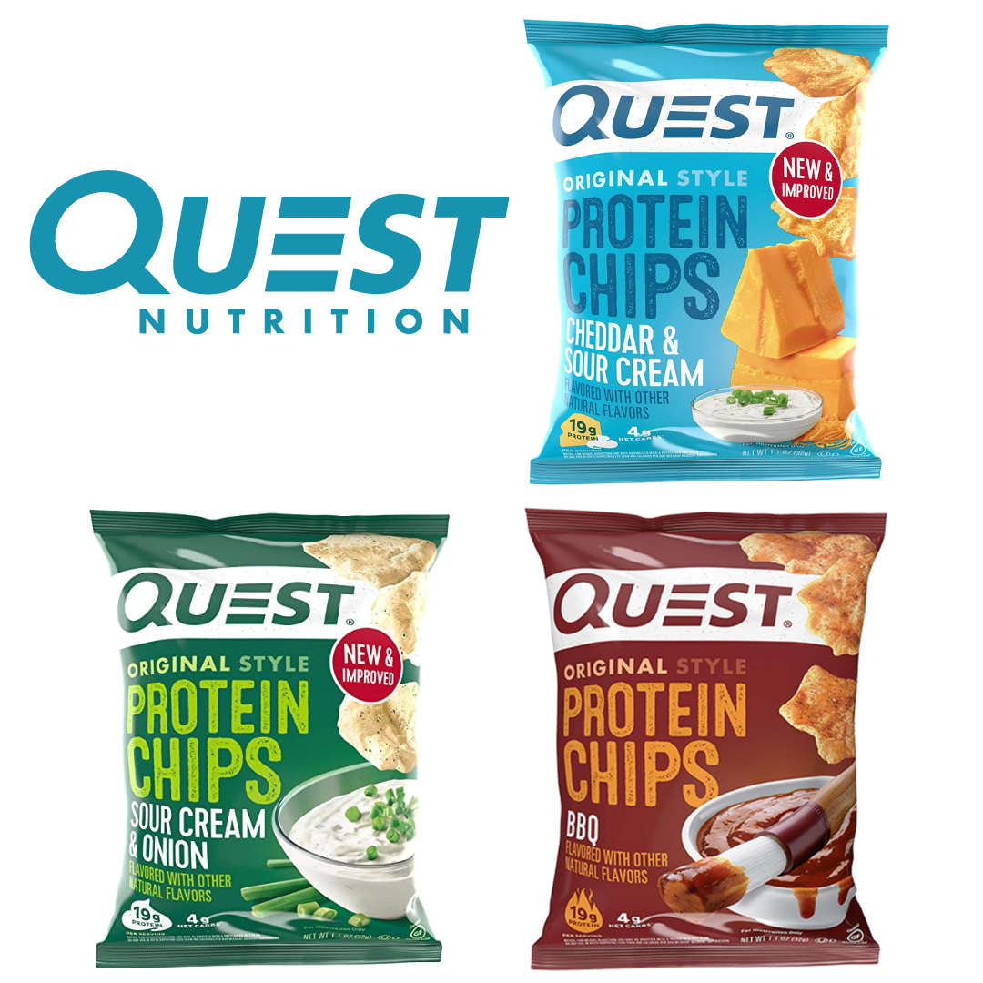
Protein chips
Dairy-based proteins to provide your body with all nine of the essential amino acids it needs.
Our custom-made protein chips are seasoned and baked to make every bite as delicious as your cravings
19 g protein
4 g carbs

Slide 26
Guilt free Brownies!!!!
Delicious protein brownies
Over 20 grams of protein
Less than 200 calories.
Low carb
Great for afternoon snacks or after dinner cravings

Slide 27
SNACK SMARTER
Roasted broad beans seasoned with various delicious flavours and packed with protein.
18 grams of protein
High in fibre
Low in sugar
Non-GMO
Gluten-free
Vegan options

Slide 28
Protein Pop-tarts !!!
Just like a Pop-Tart but packed with 20 grams of protein
Great for on-the-go snacking
Low carb (5 g)
keto-friendly,
Less than 1 gram of sugar

Slide 29
Peanut Butter Cups
This indulgent treat offers the delicious taste of traditional Peanut Butter Cups and allows your to #CHEATCLEAN.
• No Added Sugar
• Gluten Free
• 11g of Protein
• 1g Net Carbs
• Less than 1g of Sugar

Slide 30
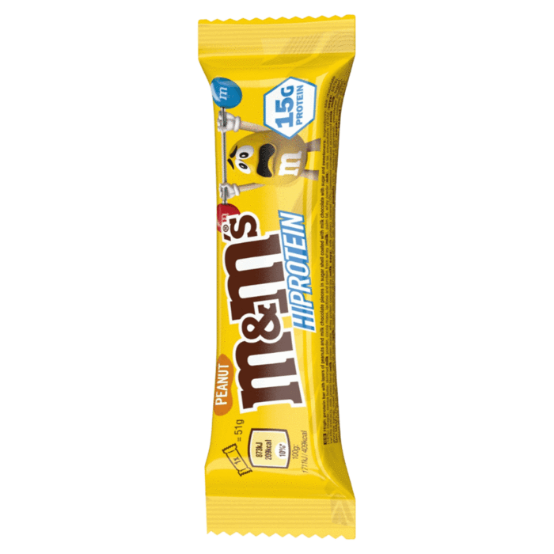
M&M’s Hi-Protein Peanut Bar
Packed and studded with ACTUAL mini M&M’s
15g protein
10g less sugar than a serving of regular (non-protein) M&M’s

Slide 31
Lenny & Larry’s is All Natural
16 g of protein
Made with only All Natural ingredients
  • Best Tasting
  • Good Source of Fiber
  • All Natural
  • No Cholesterol
  • Vegan
  • No Trans Fat
  • High Protein
  • Nothing Artificial
  • Non Dairy
  • No Sugar Alcohols
  • No Eggs
  • No High Fructose Corn Syrup
  • Non-GMO
  • Kosher

